Slide 1
Research project proposal to Indian Institute of Remote Sensing
Deep learning for low resolution hyper spectral satellite image classification
Presentation
by
Dr. E. S. Gopi,
Principle investigator of the proposed project
Co-ordinator for the pattern recognition and the computational intelligence laboratory
Associate professor
Department of Electronics and Communication Engineering,
National Institute of Technology Tiruchirappalli
Tamil Nadu, India
Dr. S.Deivalakshmi,
Co-investigator for the proposed project
Assistant professor
Department of Electronics and Communication Engineering,
National Institute of Technology Tiruchirappalli
Tamil Nadu, India

Slide 2
Objectives:
To demonstrate the developed algorithm to convert the low resolution hyper spectral images into high resolution hyper spectral images using GAN.
To construct the classifier to classify the pixels of the high resolution images (obtained from the trained GAN) into finite number of classes and to compare the performance of the classifier with the corresponding actual high resolution images
Importance: The Hyper spectral images captured with high resolution expensive.
In our proposal, we suggest to use the cost effective low resolution hyper spectral Images for the pixel wise supervised classification that performs at par with the one using high resolution Images using GAN (Generative Adversarial Network).

Slide 3
Proposed Idea:
[1] GAN was introduced during 2014 (by Ian Good fellow) that was actually developed to generate photographs. But in recent years, GAN is being used in many applications like converting MRI to the corresponding CT image, Thermal image to the corresponding visible image, low resolution to high resolution image conversion , etc.
[2] There are attempts made on GAN based Hyper spectral image classification. In this technique, GAN is used to obtain the class label of the individual pixel of the hyper spectral images directly (without increasing the resolution of the image). 3.7 m x 3.7 m per pixel
[3] In our proposal, we plan to use the low resolution hyperspectral images for classification. We use GAN network to convert the low resolution hyper spectral images into high resolution image hyper spectral images. We further use the obtained high resolution images for further classification.
Mainly in our proposed approach, we can increase the spatial resolution of the hyperspectral images that were taken with low resolution

Slide 4
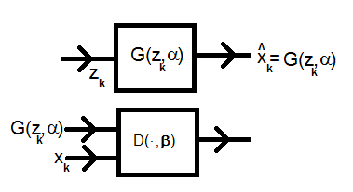
Generative Adversarial Network
Discriminator
The Discriminator is the classifier
2. The sample outcome from the random variable with pdf p data
is treated as the one belongs to the class 1
3. The sample outcome from the random variable with
pdf p x is treated as the one belongs to the class 2
4. The output of the discriminator is the
probability that the input (I) belongs to the class 1 ,
i.e. D(I , β)=p(class1/I).
5. Note that Xk belongs to class 1 and G(zk,α) belongs to class2

Slide 5
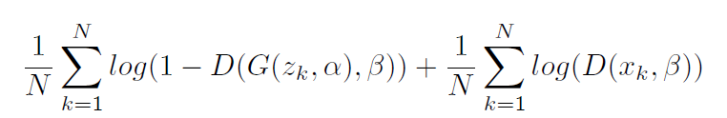
Generative Adversarial Network
Discriminator
The Discriminator is the classifier
2. The sample outcome from the random variable with pdf p data
is treated as the one belongs to the class 1
3. The sample outcome from the random variable with
pdf p x is treated as the one belongs to the class 2
4. The output of the discriminator is the
probability that the input (I) belongs to the class 1 ,
i.e. D(I , β)=p(class1/I).
5. Note that Xk belongs to class 1 and G(zk,α) belongs to class2
Given Xk and G(zk,α) (i.e.) α is fixed, we would like to optimize β to maximize the following likelihood function
Max: arg
β

Slide 6
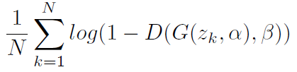
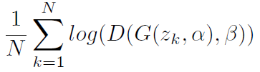
Generative Adversarial Network
Discriminator
The Discriminator is the classifier
2. The sample outcome from the random variable with pdf p data
is treated as the one belongs to the class 1
3. The sample outcome from the random variable with
pdf p x is treated as the one belongs to the class 2
4. The output of the discriminator is the
probability that the input (I) belongs to the class 1 ,
i.e. D(I , β)=p(class1/I).
5. Note that Xk belongs to class 1 and G(zk,α) belongs to class2
Given Xk and G(zk,α) (i.e.) α is fixed, we would like to optimize β to maximize the following likelihood function
Max: arg
β
Generator
Objective is to generate k th outcome x k (with pdf p data) from z K(with pdf p z)
Initially Generator generates x k (with pdf p x) and we would like the generator to generate x k with p x=p data.This implies,we would like optimize α in such a way that the Discriminator D treats the G(zk,α) to be the one belongs belongs to class 1
This implies
Max: arg
Min: arg
α
α

Slide 7
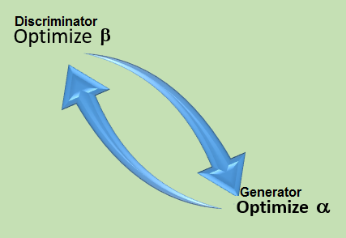
Training GAN
It can be shown that given α , optimal β is obtained when D(I)=pdata(I) / (pdata(I)+px(I)),where I is the input to the discriminator (actual Xk or G(zk, α))
Given β, the optimal α is obtained when pdata(I)=px(I) and hence convergence is attained when D(I)=1/2

Slide 8
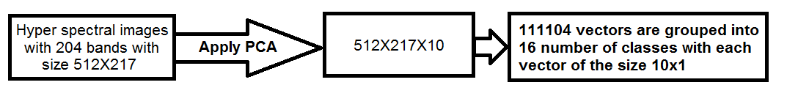
Recent approach 1: Hyperspectral Image classification using GAN*
*Lin Zhu, Yushi Chen Pedram Ghamisi and J6n At Benediktsson, Generative Adversarial Networks fo Hyperspectral Image Classification, IEEE Transactions on Gel science and Remote sensing,2018.
Typical dataset: Salinas (Airborne visible/infrared imaging spectrometer) with the resolution of 3.7 m x 3.7 m per pixel and 16 classes of interest (Brocoli_green_weeds_1, Brocoli_green_weeds_2,…Vinyard_vertical_trellis)

Slide 9
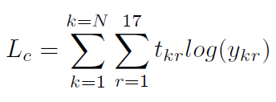
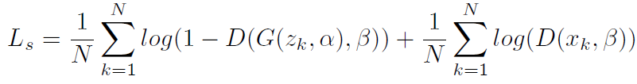
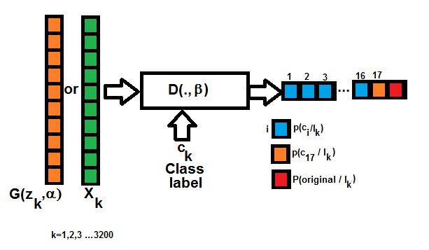
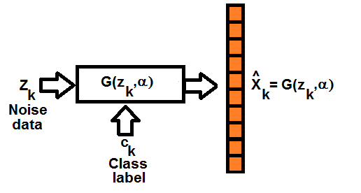
Recent approach 1: Hyperspectral Image classification using GAN*
Discriminator (Lc+Ls)
Generator (Lc-Ls)

Slide 10
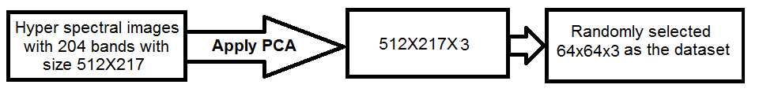
Recent approach 2: Hyperspectral Image classification using GAN*

Slide 11

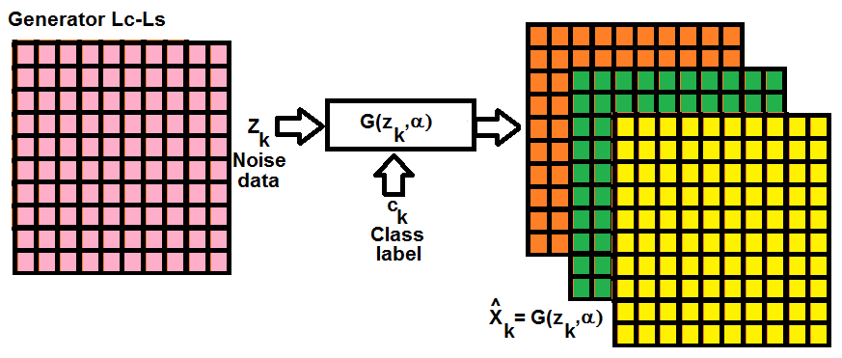
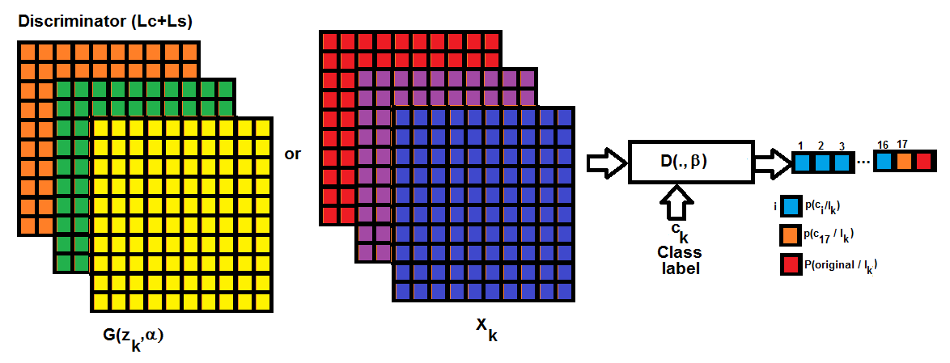
Recent approach 2: Hyperspectral Image classification using GAN*
Note: In this case, the complete 64x64 is classified as the one belonging to the particular class

Slide 12
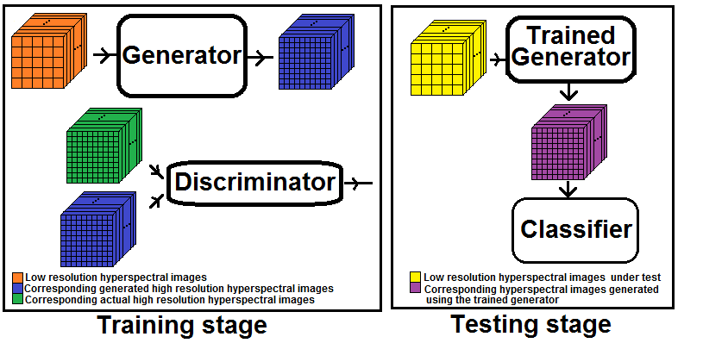
Our proposed approach 1 *:
Based on the paper:
Christian Ledig et.al. Photo-Realistic Single Image Super Resolution Using a Generative Adversarial Network, 2017 lEEE Conference on Computer Vision and Pattern recognition,2017,IEEE Conference on Computer Vision and Pattern recognition
Generator is trained to minimize perceptual loss function
[1]Content loss (a) MSE loss and/or (b) Euclidean distance between the feature representation of the reconstructed image and the reference image
[2]Adversarial loss:
Discriminator tries to maximize

Slide 13
Outline of the proposed technique
In Generative Adversarial Network, we have two convolution network structures. One acts as the generator block and the other as the discriminator block
Group of hyper spectral images (Full or sublocks) are given as the input to the generator block. The generator block tries to convert the group of low resolution images into group of corresponding high resolution images. The generated high resolution images, along with the corresponding actual high resolution images are given as the input to the discriminator.
The discriminator network is trained such that the variable associated with the output of the discriminator takes the value 0.5 (for the ideal cases) for both original high resolution image and the high resolution image obtained from the generator. This is done to make sure that the discriminator is not able to discriminate the original high resolution image and the one generated by the generator.
The high resolution image (corresponding to the low resolution image under test) is obtained using the trained generator and are subjected to the classification using the classifier like Support Vector Machine. This approach has the advantage of making use of correlation between different spectral bands during training phase. As batch processing is involved during the training phase, slow convergence is expected.
Alternative approach:
Instead of using single GAN, 220 different GANs (one for each spectral band) is considered. Upon training, classification is done by combining the decision taken by the individual trained GAN. As the complexity of the individual GAN is limited, we expect fast convergence in this approach.

Slide 14


Expertise of the principle Investigator
Name: Dr. E.S. Gopi, Co-ordinator for the pattern recognition and the computational intelligence laboratory
Associate professor,
Electronics and Communication Engineering, National Institute of Technology Tiruchirappalli
Area of interest: Pattern recognition, Computational intelligence, Signal processing
Relevant (Books):
Selective journal publications:
[1] G.Jayabrindha, E.S.Gopi, "Ant Colony Technique for Optimizing the Order of Cascaded SVM Classifier for Sunflower Seed Classification" , IEEE Transactions on Emerging Topics in Computational Intelligence,pp.78 - 88, Vol.2, Issue 1, 2017.
[2] E.S.Gopi, "Digital image forgery detection using artificial neural network and independent component analysis", Elsevier journal on Applied Mathematics and Computation (Impact factor:1.738) ,Vol. 194-2, 2007, pp. 540-543. ISSN:0096-3003
[3] E.S.Gopi, P.Palanisamy "Neural network based class-conditional probability density function using kernel trick for supervised classifier", Elsevier journal on neuro computing (Impact factor:3.317), Vol.154, pp. 225-229, 2014, ISSN:0925-2312
[4] E.S.Gopi,P.Palanisamy, "Maximizing Gaussianity using kurtosis measurement in the kernel space for kernel linear discriminant analysis", Elsevier journal on neuro computing (Impact factor:3.317),Vol.144, pp.329-337, 2014, ISSN:0925-2312
[5] E.S.Gopi, P.Palanisamy "Formulating particle swarm optimization based membership linear discriminant analysis", Elsevier journal on swarm intelligence and evolutionary computation (Impact factor:3.893) , Vol.12, pp.65-73, 2013, ISSN:2210-6502
[6] E.S.Gopi, P.Palanisamy, "Fast computation of PCA bases of image subspace using its inner-product subspace", Elsevier journal on Applied Mathematics and Computation (Impact factor:1.738), Vol.219-12, pp.6729-6732, 2013, ISSN:0096-3003

Slide 15
Other reviewed Book chapters and conference publications:
[1] Florintina.C, E.S.Gopi, "Music composition inspired by sea wave patterns observed from beaches", Proceedings of the 2nd International Conference on Data Engineering and Communication Technology (ICDECT 2017), Springer,2018.
[2] Kshitij Rachchh, E.S.Gopi, "Inclusion of Vertical bar in the OMR sheet for Image Based Robust and Fast OMR Evaluation Technique using Mobile Phone Camera ",Proceedings of the 2nd International Conference on Data Engineering and Communication Technology (ICDECT 2017), Springer, 2018
[3] Vineetha Yogesh, E.S.Gopi, Shaik Mahammad, "Particle Swarm Optimization based HMM parameter estimation for spectrum sensing in Cognitive radio system", Edited volume on Computational intelligence for Pattern Recognition, Springer, 2018.
[4] C. Florintina, E.S.Gopi, "Constructing a Linear Discrete System in Kernel Space as a Supervised Classifier",- Wispnet 2017, Chennai, 22-24 March 2017.
[5] Jay.K.Patel and E.S.Gopi, ‘’Musical Notes identification using Digital signal processing’’, Elsevier journal on procedia computer science (Cite score: 1.03) , Volume 57, 2015, Pages 876–884
[6] Hari Babu Padarthi and E.S.Gopi, ‘’ Medical data classifications using Genetic algorithm based Generalized Kernel Linear Discriminant analysis’’, Elsevier journal on procedia computer science (Cite score:1.03), Volume 57, 2015, Pages 868–875
[7] E.S.Gopi, P.Palanisamy, "Scatter Matrix versus the Proposed Distance Matrix on Linear Discriminant Analysis for Image Pattern Recognition", Springer, pp.101-108, 2014
[8] Hemant Sharma and E.S. Gopi. "Signal processing approach for music synthesis using bird’s Sounds", Elsevier journal on Procedia Technology , Volume 10, 2013, Pages 287-294
[9] Vinoth S and E S Gopi. ‘’Neural network modeling of color array filter for digital forgery detection using kernel LDA’’, Elsevier journal on Procedia Technology , Volume 10, 2013, Pages 287-294
[10] E.S.Gopi, P.Palanisamy, "Formulating Particle Swarm Optimization based Generalized Kernel Function for Kernel-Linear Discriminant Analysis", Elsevier journal on Proceedia technology, Vol.6, pp.517-525, 2013
[11] E.S.Gopi, R.Lakshmi, N.Ramya, and S.M. Shereen Farzana, "Music indexing using Independent Component Analysis with pseudo-generated sources,Independent Component Analysis and Blind Signal Separation", Springer Berlin Heidelberg,pp.1237-1244, 2004

Slide 16
Expertise of the Co-Investigator

Slide 18
Work plan:
Data base and analysis
[1] Proof of the concept of the developed algorithm is demonstrated using widely used dataset like
Salinas with 204 bands [after removal of low signal to noise ratio bands]. Captured using Airborne Visible/Infrared imaging (AVIRAS), 512x217 pixels. Number of classes-16
KSC dataset NASA (AVIRAS) with 176 bands (after removal of low signal to noise ratio bands), 512x 614 pixels, Number of classes-13
Indian Pines test with 200 spectral bands (after removal of low signal to noise ratio bands), 145x145 pixels, Number of classes-16
[2] Upon completion of proof of concept, the developed algorithm is tested using Hyper spectral images collected from ISRO. Example: Hyper spectral images collected from the Mangrove Ecosystem. This needs assistance from ISRO for the proper selection of the dataset.
Linkage to space program and the Deliverables to IIRS:
[1] Demonstration of the performance of the developed algorithm on the hyper spectral satellite images (collected from ISRO) like the one collected from Mangrove forest.
[2]High quality research publications (based on the research) and Books/ Book chapters.
[3] Completion of the Ph.D. - 1 student

Slide 19
Budget Requirement:
Amount of grant requested (in Rs.) 1st Year, 2nd Year, 3rd Year Total | First year=11,04,000 Second year=4,38,000 Third year=4,81,200 Total=20,23,200
Manpower | 9,36,000
Equipment | 5,00,000
Satellite Data/Data | 50,000
Consumables & Supplies | 35,000
Internal Travel | 1,50,000
Contingency | 15,000
Others | 0
Overheads | 3,37,200
Total | 20,23,200

Slide 20
References:
[1] IanJ.Goodfellow, JeanPouget-Abadie∗, MehdiMirza, BingXu, DavidWarde-Farley, SherjilOzair†, AaronCourville, YoshuaBengio, “Generative Adversarial Nets”, Proceedings of Neural Information Processing Systems 2014.
[2] Christian Ledig et.al. Photo-Realistic Single Image Super Resolution Using a Generative Adversarial Network, 2017 lEEE Conference on Computer Vision and Pattern recognition.
[3] Lin Zhu, Yushi Chen Pedram Ghamisi and J6n At Benediktsson, Generative Adversarial Networks fo Hyperspectral Image Classification, IEEE Transactions on Gel science and Remote sensing.

Slide 21
Thank you!!!

